Slide 1

Evaluation of 5G Open RAN simulation environments
Research Project
Professor: Dr.-Ing. Andreas Grebe
Student: Md Nur Mohammad
Student ID: 11145131
Master in Communication Systems and Networks

Slide 2
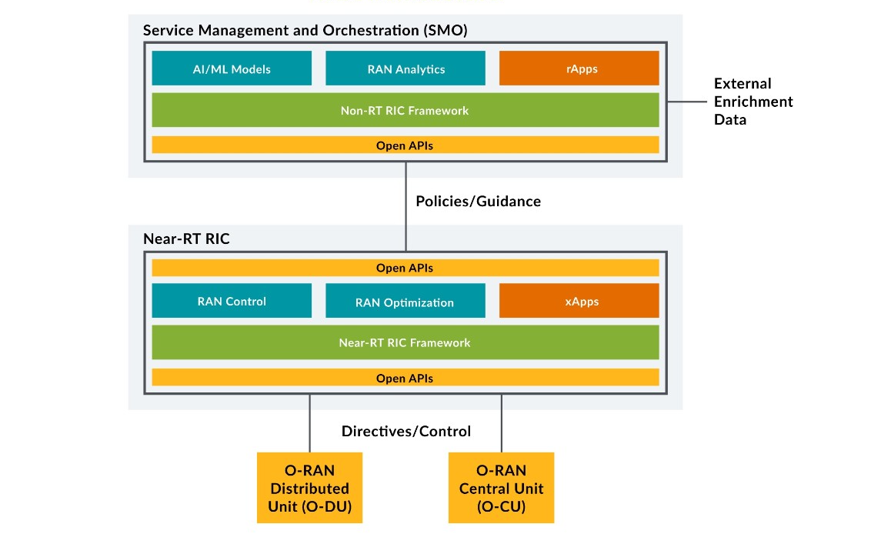

Slide 3
Last Meeting Details
Meeting (27.04.2023)
Build policy service.

Slide 4
Last week work

Slide 5
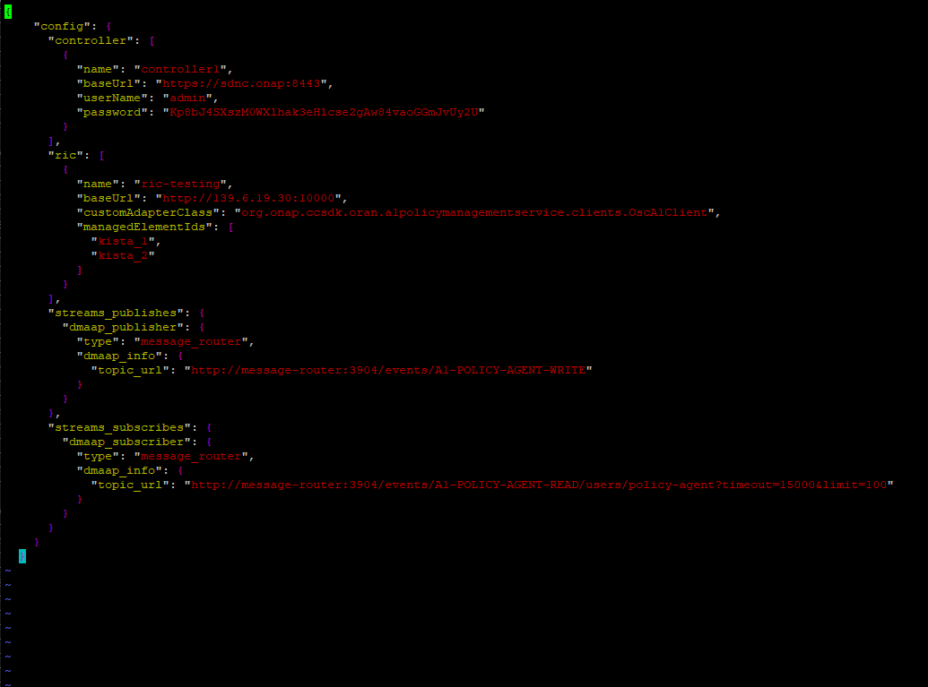
Create Policy

Slide 6
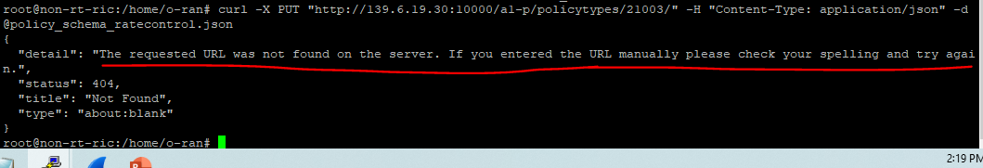
Error to Create Policy type

Slide 7
Possible issue
policy_schema_ratecontrol.json file is wrong with this specific f-release. (This file is given by developer)

Slide 8
Next Attempt
Shift f-release to Latest G-Release.

